Slide 1
IMAGE CAPTION GENERATOR
Under the guidance of:
Dr. Sumit Hazra
TEAM-5:
BHAVANI TADIMALLA
2310030003

Slide 2
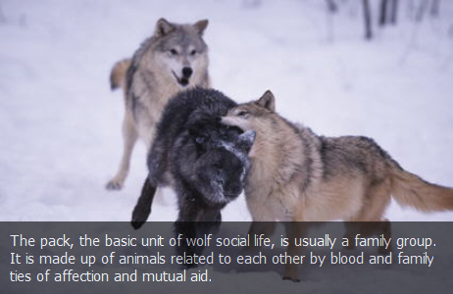
Introduction
Interpreting and describing images in intuitive for humans but challenging for machines.
Helps the visually impaired understand images.
Useful in social media, content indexing and digital asset management.
Important task combining computer vision and natural language processing.
Helps in image retrieval and organization.
Powers applications like virtual assistants and smart cameras

Slide 3
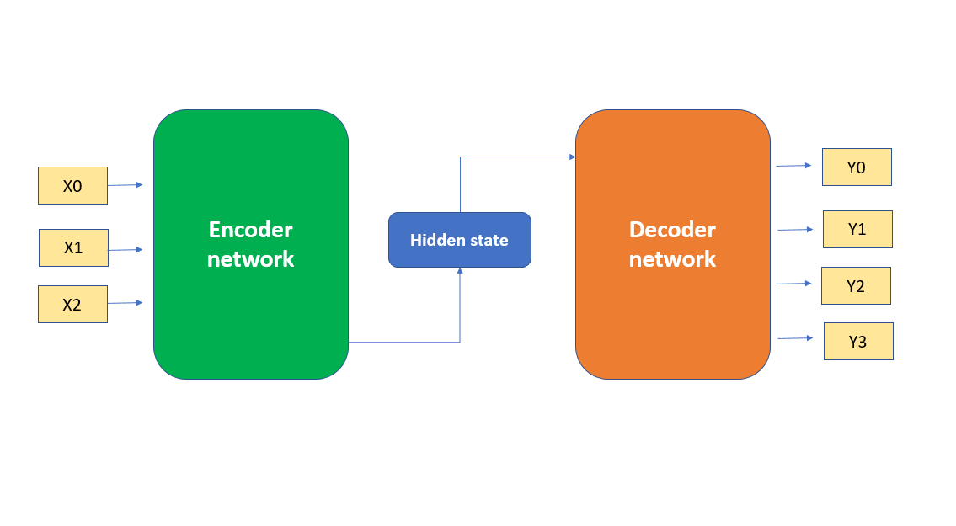
Methodology
The encoder (Computer Vision):
To take an image and encode it into a
numerical representation. Typically, a pre-
trained Convolutional Neural Network to
remove the final classification layer and
penultimate layer. This part shows essential
visual information of image.
The Decoder (Natural language processor):
To take the feature from encoder and
decode it into sequence of words. A
Recurrent Neural Network processes the image
feature as an input. It generate words being
predicted based on image features. This
continues until end of sentence is generated.

Slide 4
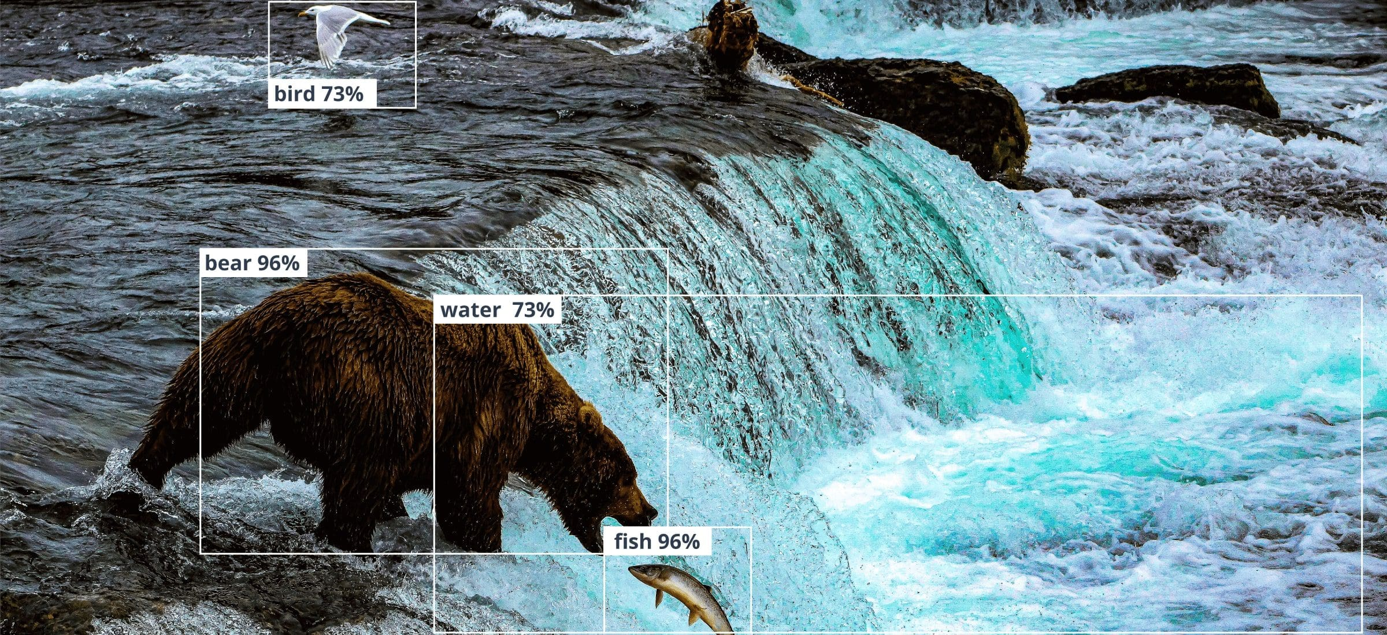
Results and future work
Challenges:
Ambiguity: An image can have multiple valid captions.
Lack of Detail: Models often generate generic captions rather than specific ones
Handling Unseen Objects: The model might struggle with objects or actions it has not seen in the training data.
Future Scope:
Attention Mechanisms: Using attention to allow the model to focus on specific parts of the image while generating each word.
Video Captioning: Extending the model to generate captions for videos.
Interactive Captioning: Allowing a user to ask questions about the image.

Slide 5
THANK YOU

